Slide 1
Foundations of Machine Learning
Module 4:
Part D: Bayesian Networks
Sudeshna Sarkar
IIT Kharagpur

Slide 2
Why Bayes Network
Bayes optimal classifier is too costly to apply
Naïve Bayes makes overly restrictive assumptions.
But all variables are rarely completely independent.
Bayes network represents conditional independence relations among the features.
Representation of causal relations makes the representation and inference efficient.

Slide 3
Late wakeup
Accident
Rainy day
Traffic Jam
Meeting postponed
Late for Work
Late for meeting

Slide 4
Bayesian Network
A graphical model that efficiently encodes the joint probability distribution for a large set of variables
A Bayesian Network for a set of variables (nodes) X = { X1,…….Xn}
Arcs represent probabilistic dependence among variables
Lack of an arc denotes a conditional independence
The network structure S is a directed acyclic graph
A set P of local probability distributions at each node (Conditional Probability Table)

Slide 5
Representation in Bayesian Belief Networks
Late wakeup
Accident
Rainy day
Conditional probability table
associated with each node
specifies the conditional
distribution for the
variable given its immediate
parents in
the graph
Traffic Jam
Meeting postponed
Late for Work
Late for meeting
Each node is asserted to be conditionally independent of
its non-descendants, given its immediate parents

Slide 6
Inference in Bayesian Networks
Computes posterior probabilities given evidence about some nodes
Exploits probabilistic independence for efficient computation.
Unfortunately, exact inference of probabilities in general for an arbitrary Bayesian Network is known to be NP-hard.
In theory, approximate techniques (such as Monte Carlo Methods) can also be NP-hard, though in practice, many such methods were shown to be useful.
Efficient algorithms leverage the structure of the graph

Slide 7
Applications of Bayesian Networks
Diagnosis: P(cause|symptom)=?
Prediction: P(symptom|cause)=?
Classification: P(class|data)
Decision-making (given a cost function)
cause
cause
symptom
symptom

Slide 8
Bayesian Networks
Structure of the graph ⬄ Conditional independence relations
Requires that graph is acyclic (no directed cycles)
2 components to a Bayesian network
The graph structure (conditional independence assumptions)
The numerical probabilities (for each variable given its parents)
In general,
p(X₁, X₂,....X_{N}) = Π p(X_{i} | parents(X_{i} ) )
The full joint distribution
The graph-structured approximation

Slide 9
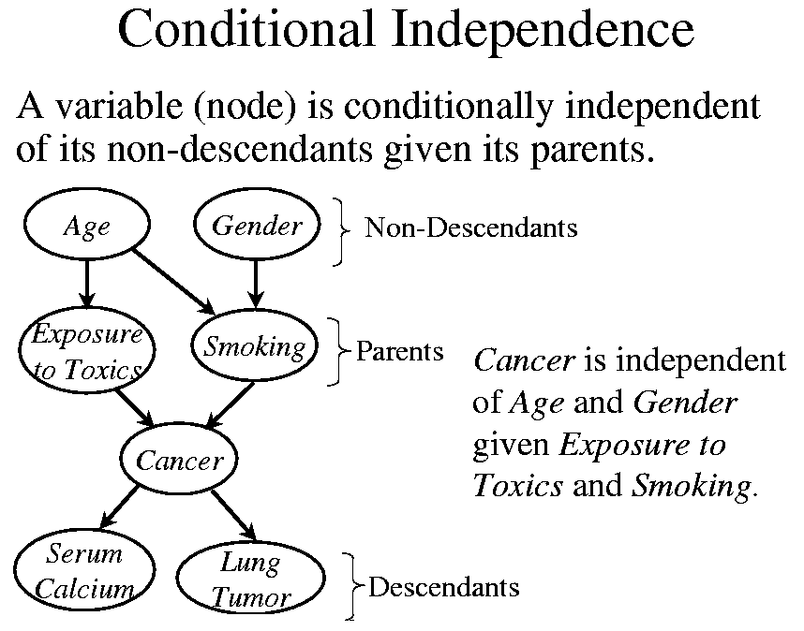

Slide 10
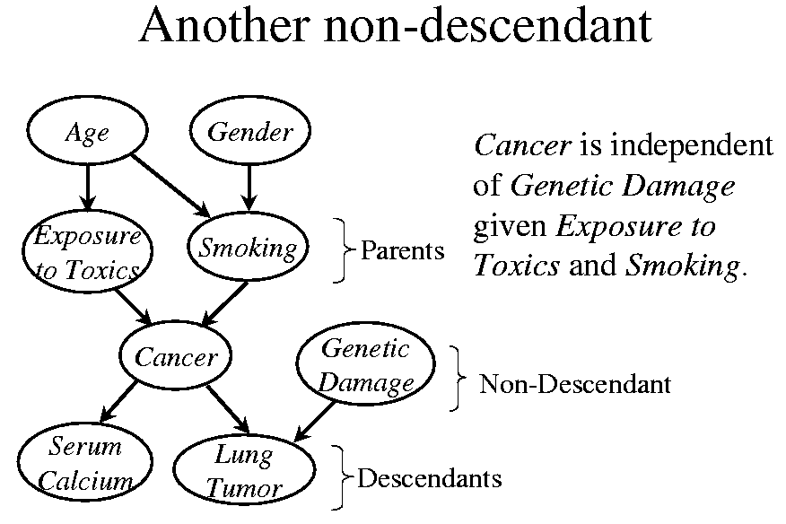

Slide 11
Examples
A
B
C
Marginal Independence:
p(A,B,C) = p(A) p(B) p(C)
A: D
Conditionally independent effects:
p(A,B,C) = p(B|A)p(C|A)p(A)
B and C are conditionally independent
Given A
B: S1
C: S2
A: Traffic
B: Late wakeup
Independent Causes:
p(A,B,C) = p(C|A,B)p(A)p(B)
“Explaining away”
C: late
A
B
C
Markov dependence:
p(A,B,C) = p(C|B) p(B|A)p(A)

Slide 12
Naïve Bayes Model
Y₁
Y₂
Y₃
Y_{n}
C

Slide 13
Hidden Markov Model (HMM)
Observed
Y₁
Y₂
Y₃
Y_{n}
- - - - - - - - - - - - - - - - - - - - - - - - - - - - - - - - - - - - - - - - - - - - - - - - - - - -
S₃
S_{n}
Hidden
S₁
S₂
Assumptions:
1. hidden state sequence is Markov
2. observation Y_{t} is conditionally independent of all other variables given S_{t}
Widely used in sequence learning eg, speech recognition, POS tagging
Inference is linear in n

Slide 14
Learning Bayesian Belief Networks
The network structure is given in advance and all the variables are fully observable in the training examples.
estimate the conditional probabilities.
2. The network structure is given in advance but only some of the variables are observable in the training data.
Similar to learning the weights for the hidden units of a Neural Net: Gradient Ascent Procedure
3. The network structure is not known in advance.
Use a heuristic search or constraint-based technique to search through potential structures.

Slide 15
Thank You

